Slide 1
Network Config Optimization
Mingjun Wang

Slide 2
Agenda
Problem Statement
Proposal
Model Detail
Result
Conclusion

Slide 3
Problem Statement
How can we help network engineers to search out the optimized configuration using an intelligent way.
Least possible investment.
Improve network performance
Everage hops between each src/dest
Everage time spent between each src/dest

Slide 4

Proposal – Deep RL
Train a Deep RL Based agent to search the best config for the network.
Best for solving sequential decision-making problems.
Train a policy to optimize a series of the actions.
= Deep Learning + RL

Slide 5
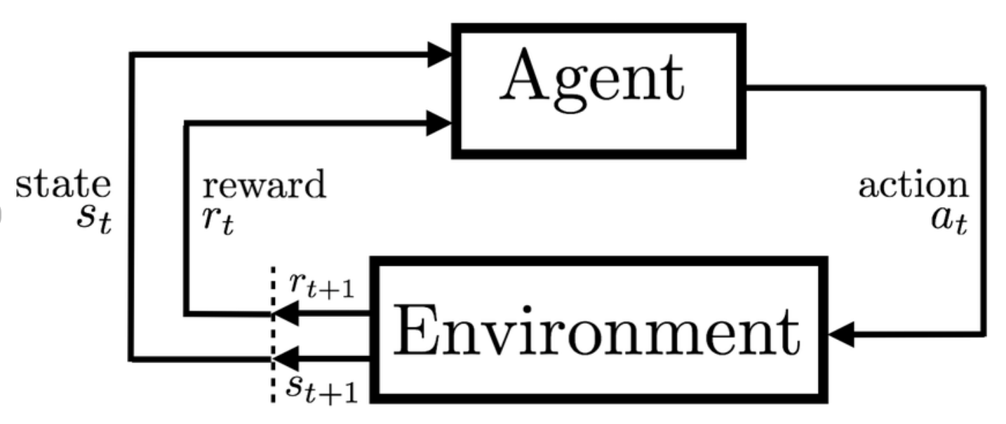

RL Key Concepts
Assuming Markov Decision Process(S, A, R, P)
State(s):
Current available information about the Env.
Action(a):
Next hop, etc.
Reward(r): r
Immediate feedback from Env after an action from an agent upon the Env.
Return(G):
Reinforcement Learning: An Introduction

Slide 6

RL Key Concepts
Value function(V):
Policy π(a|s):
Mapping from state to action. Can be stochastic or deterministic.
Goal of RL is to train a policy that maximize value function V or Q.
Generalized Policy Iteration:
Foundation framework of all RL algorithms
Generalized Policy Iteration:
Initial Policy π(a|s, ), value function Q(s,a)
Initial state s
Loop forever:
Emit action a given π and s
Evaluate Q(s,a) also called critic
Improve Policy π as called actor
Update s

Slide 7
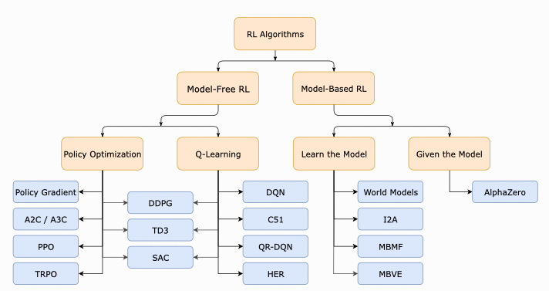
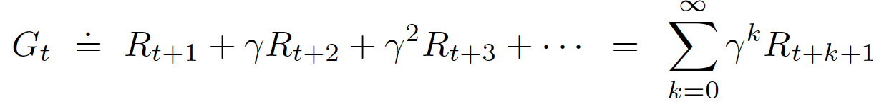
RL Algorithms

Slide 8
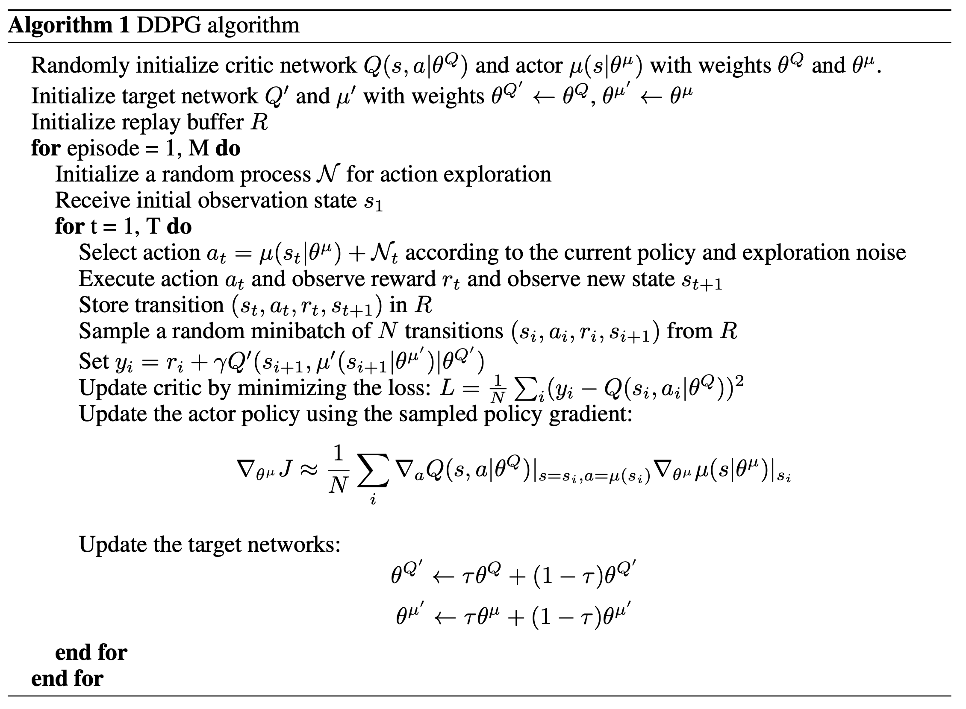
Deep Deterministic Policy Gradient
Model free based.
A type of Actor-Critic model.
Off policy algorithm.
Utilizes previous experiences
Continues action space.
Deterministic Policy π(s).

Slide 9
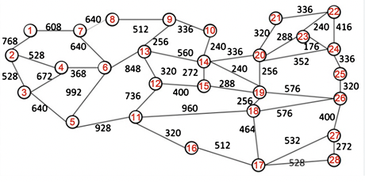
What We have -- Data
A network simulator powered by Batfish.
Total nodes: 26
Total link: 62
Total src/dest combinations: 325
Protocol: OSPF
Available bandwidths:
[10, 100, 1,000, 10,000, 25,000, 40,000, 100,000]
Our Goal
Find the best config that has the shortest average path for each src and dest.

Slide 10
Model Specification
Model Design
State: Bandwidth/cost for each src and dest.
Dimension: 325
Action: Bandwidth for each link.
Dimension: 62
Reward: Negative total number of hops for each src and dest.
Note: state, action and reward are normalized.
Hyper Parameters
Lr: 0.01
Episode length: 15
Number of episode: 100
Batch size: 30
Buffer size: 1,000
Number of hidden layers: 2(200,100)
Number of GPUs: 1
Note: the shortest runtime: 3 days.

Slide 11
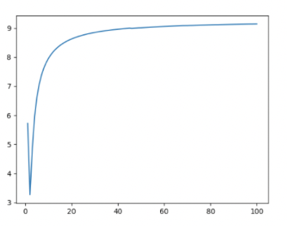
Model Results
Everage hops for each src/dest
From RL: 4.5
Random: 5.5
Engineers?
Return for Each Episode
Number of Episodes

Slide 12
Conclusion/Future Improvement
RL agent can offer a better configuration!
Use a stochastic policy.
Remove adjacent src/dest.
Use 2d array rather than 1d as state.
Graph Neural Network.

